Slide 1

美食华章
第6组
方晴 陆铧恩 李馨竹 温洪刚

Slide 2




Catalogue
1
2
APP Introduction
3
Marketing Analysis
4
Financial Key Indicators
Operating

Slide 3
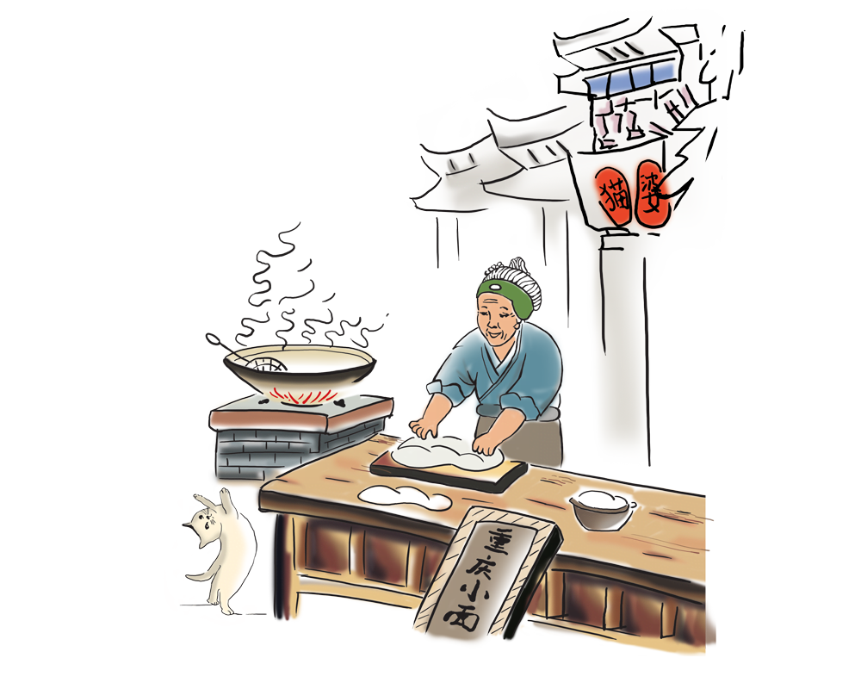
APP Introduction
1

Slide 4

The issues the application solves
Convenient search for traditional cuisine
It provides information about traditional cuisine, making it easy for users to search for them.
Introduction to traditional cuisine culture
Traditional Chinese cuisine is deeply rooted in culture.
Provide recipes for traditional cuisine
Some complicated recipes are shown.
Provide recommendations and reviews for traditional cuisine
Providing recommendations and reviews for those who want to taste the traditional cuisine.

Slide 5
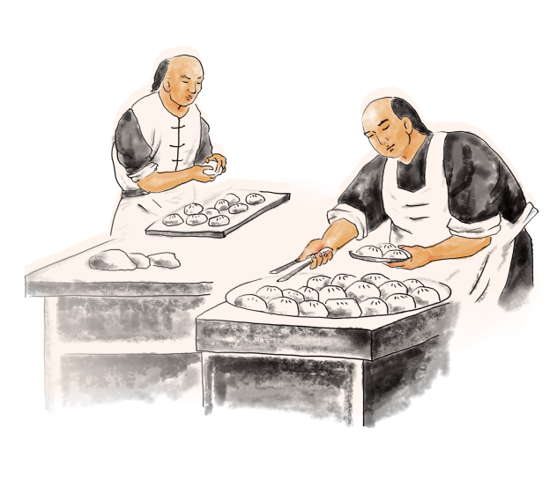
User and target market
Foreigners interested in traditional Chinese cuisine
Domestic and international tourists
Domestic users interested in Chinese cuisine
Cooking enthusiasts

Slide 6


Innovation
Authentic and Rich Content
Personalized Recommendation Function
Social Function

Slide 7
Marketing Analysis
2

Slide 8
PESTLE Analysis
Dimension | Analysis
Political | 1. Epidemic prevention 2. A number of policies to promote tourism
Economic | The forecast growth rate of GDP in 2023 will reach around 6%
Social | 1. Short video platform promotes the development of tourism 2. Good social development trend 3. Rich food culture
Technology | Scientific and technological development stimulates the willingness to travel
Legal | Tourism industry has a complete tourism system
Econological | At present, the tourism industry attaches great importance to the ecological environment.

Slide 9

SWOT Analysis
Strength
Weakness
1. Focus on the popularization of local food culture, with strong pertinence;
2. It takes short time to use, convenient;
3. Wide market scope and strong competitiveness.
1. Business is relatively simple.
Opportunities
Threats
1. The recovery of tourism;
2. The combination of food activities and tourism can form a unique tourism market;
3. Chinese food culture is extensive and profound, and the promotion and communication is conducive to responding to the call of the country
1. Big platform competition.

Slide 10
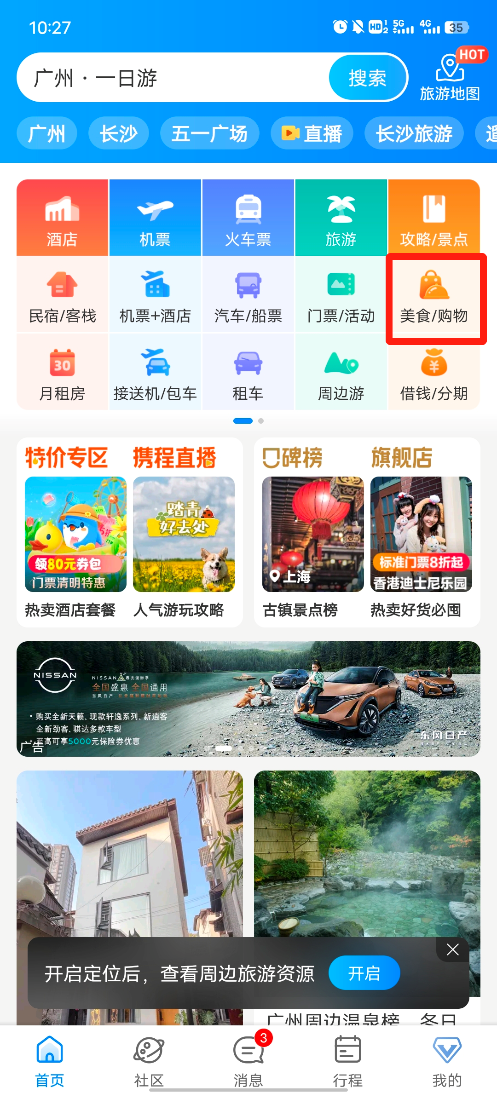
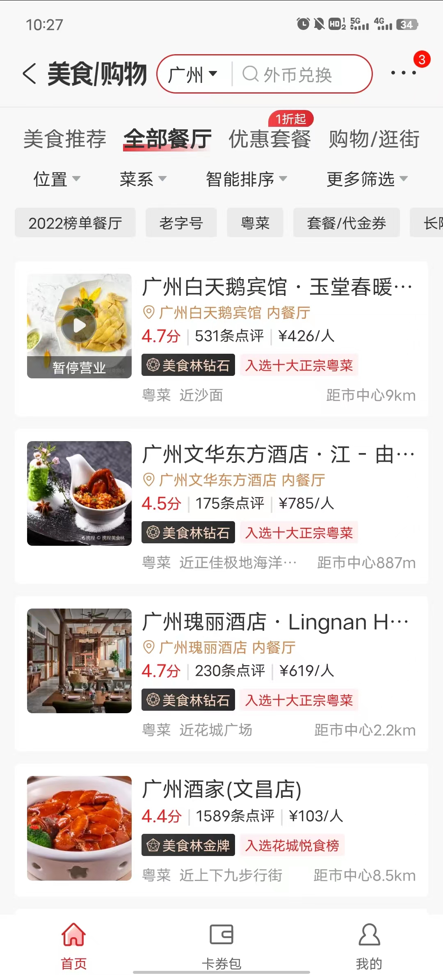
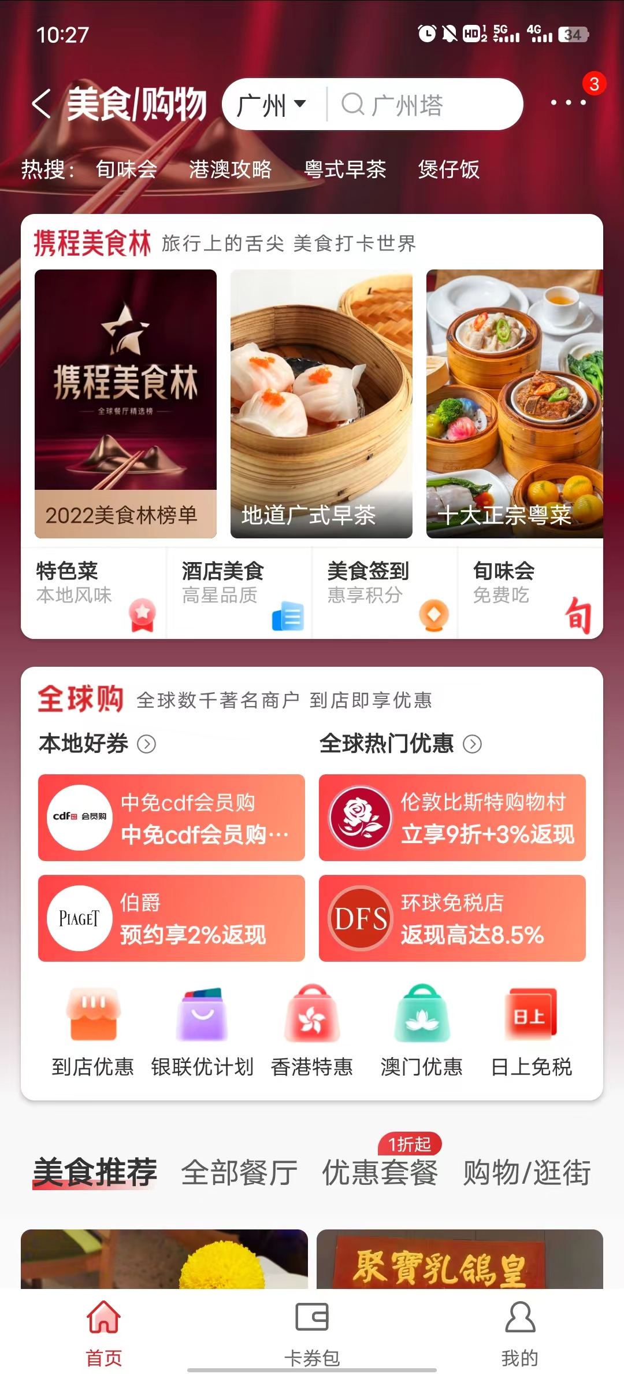
Channels to Validate an App
App Store
Competitors Analysis
Ctrip
Strengths:
1. The tourism industry has perfect services, a large number of users and a certain market share;
2. List local specialties and recommend local restaurants.
Weakness:
1. The popularity of food is superficial and not deeply involved in the historical background;
2. The layout of the food interface is not obvious, which is not the main business, and the usage rate is low.

Slide 11
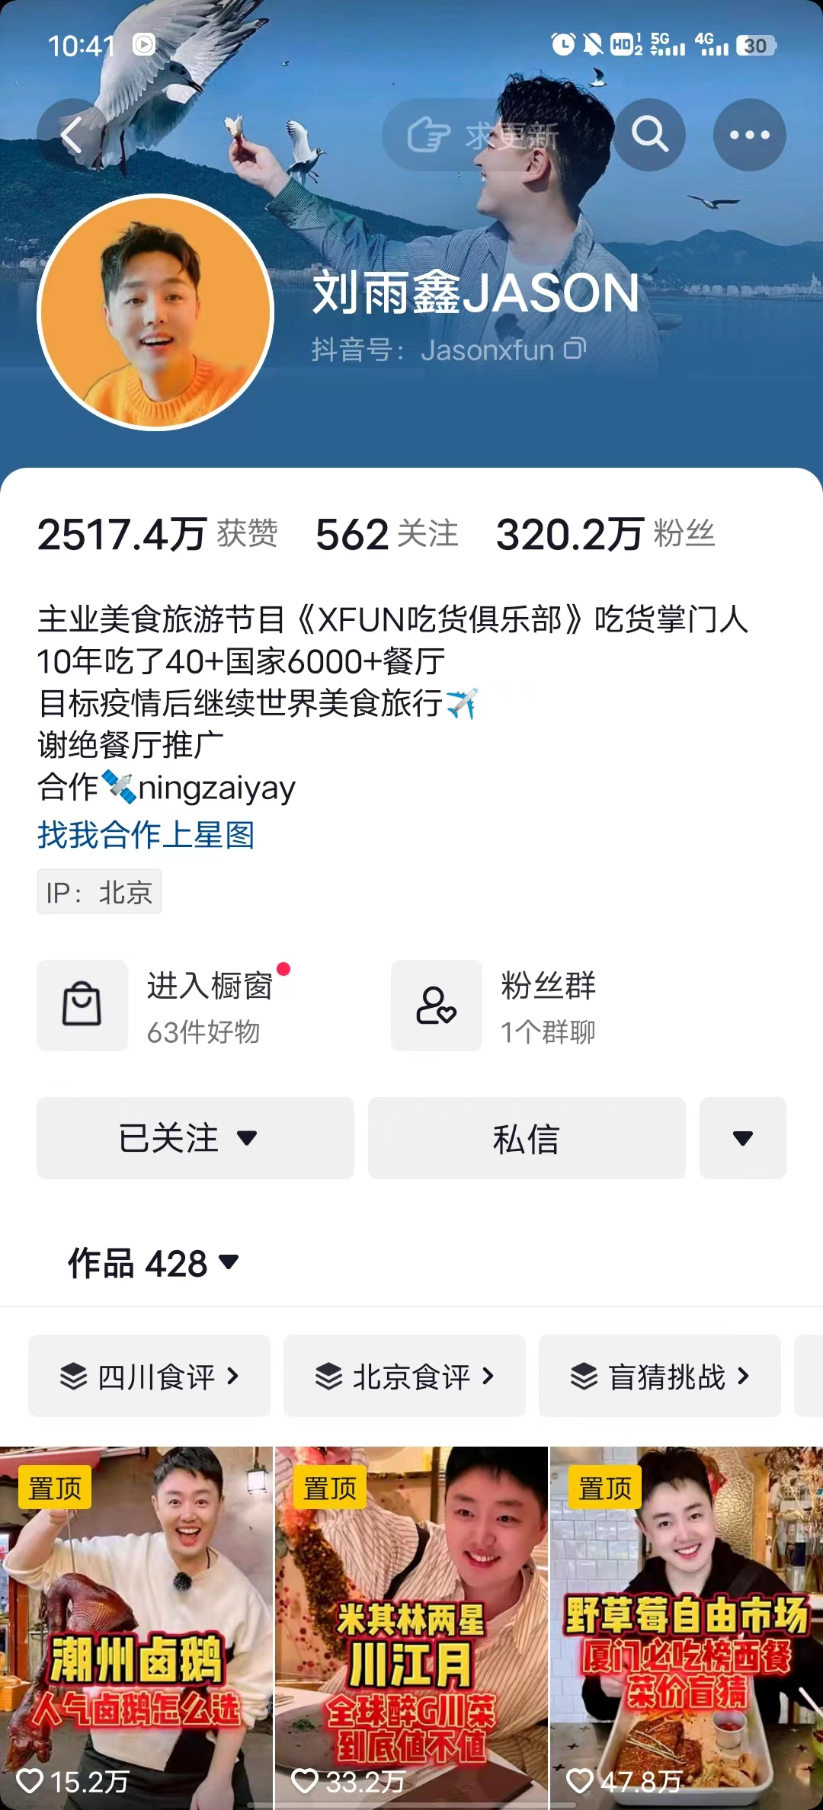
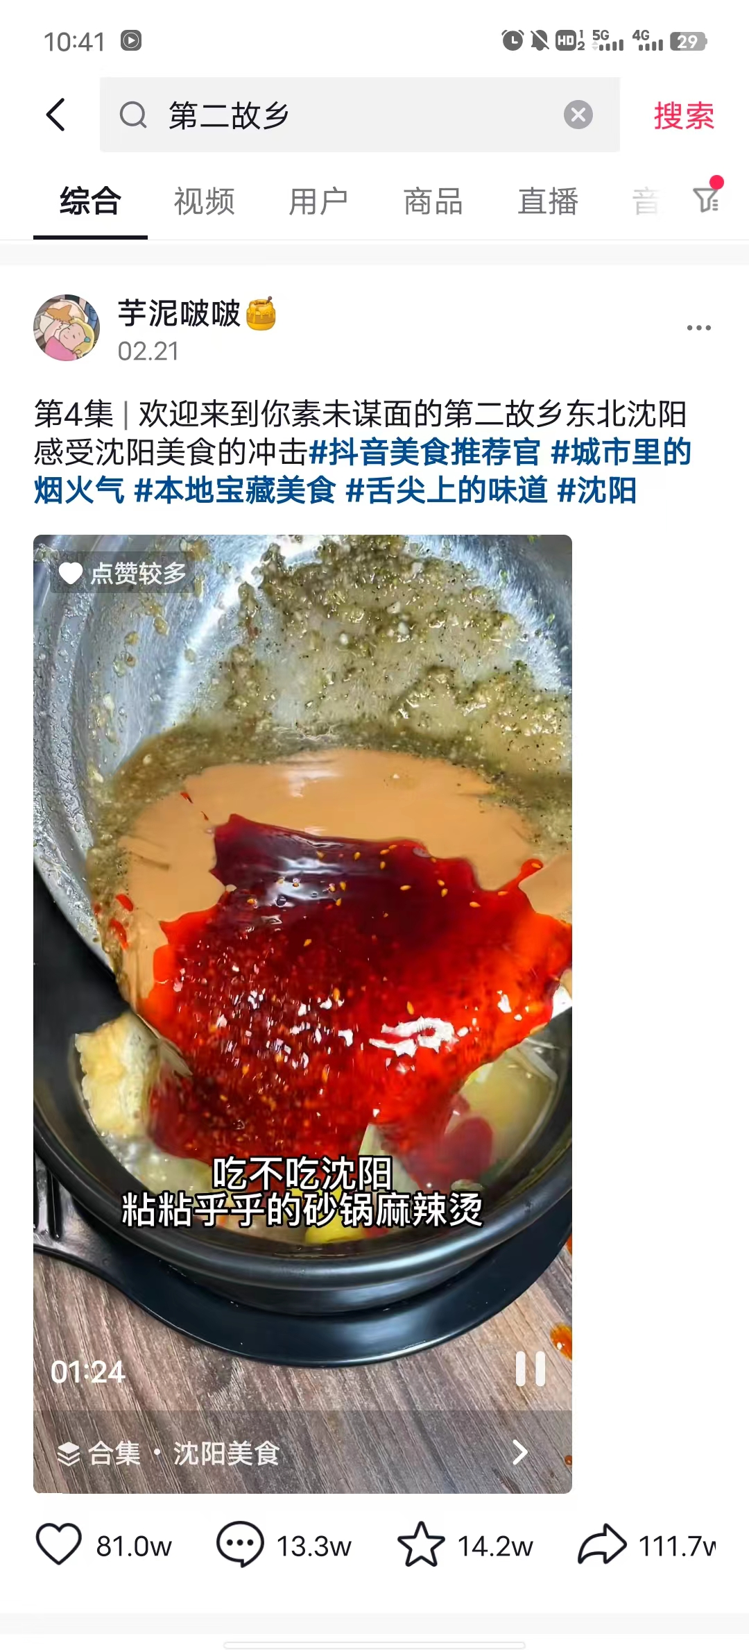
Channels to Validate an App
App Store
Competitors Analysis
Douyin
Strengths:
1. Short videos are hot. In a short time, It can learn about the traditional food around the country through the interesting introduction video of the blogger, which is more attractive.
Weakness:
1. There is suspicion of a large number of advertisements, and the authenticity of food promotion is not guaranteed;
2. The Douyin platform will limit the stream, and some videos that promote food with intent cannot be seen by most people.

Slide 12
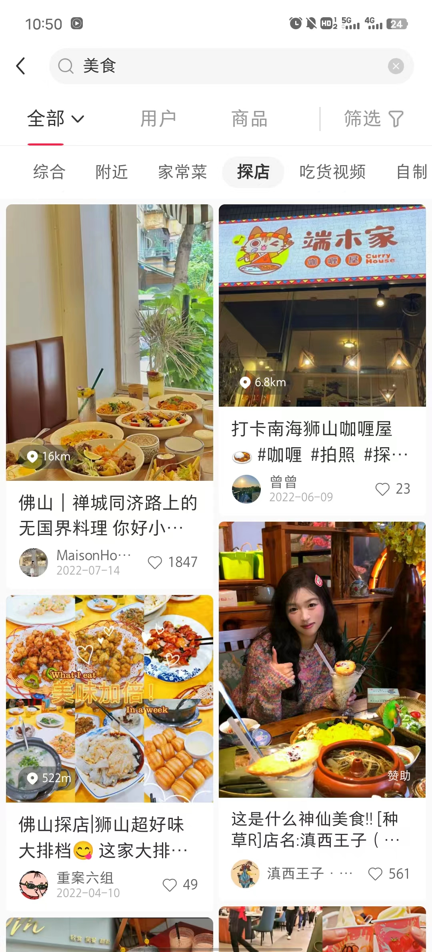
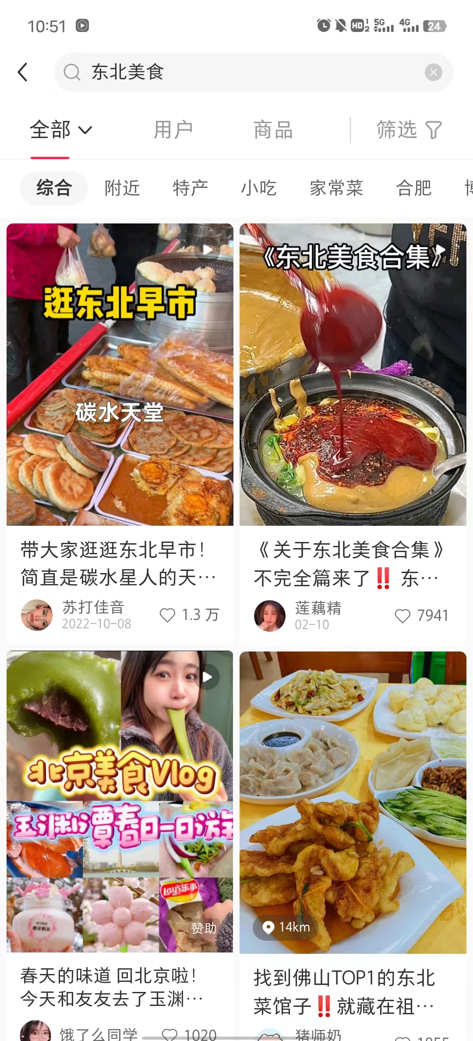
Channels to Validate an App
App Store
Competitors Analysis
Xiaohongshu
Strengths:
1. Powerful social functions. The platform is very interactive.Users can through friends recommendation or platform to find the favorite food, traditional food is promoted successfully.
Weakness:
There is a large number of advertising suspicion, filter heavy;
The general audience has a stereotype of Xiaohongshu. Most of the brand image of Xiaohongshu stays on beauty makeup and wear.

Slide 13
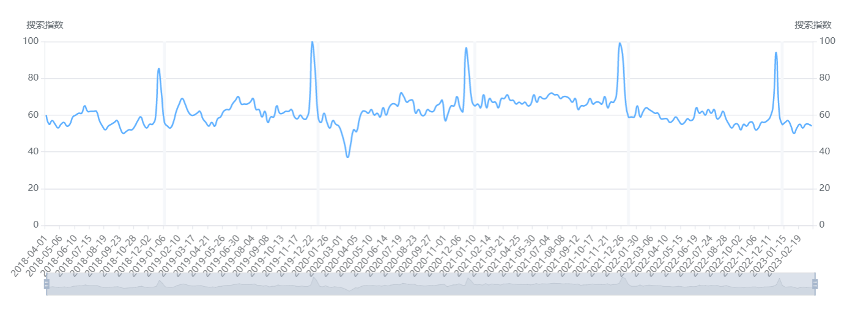
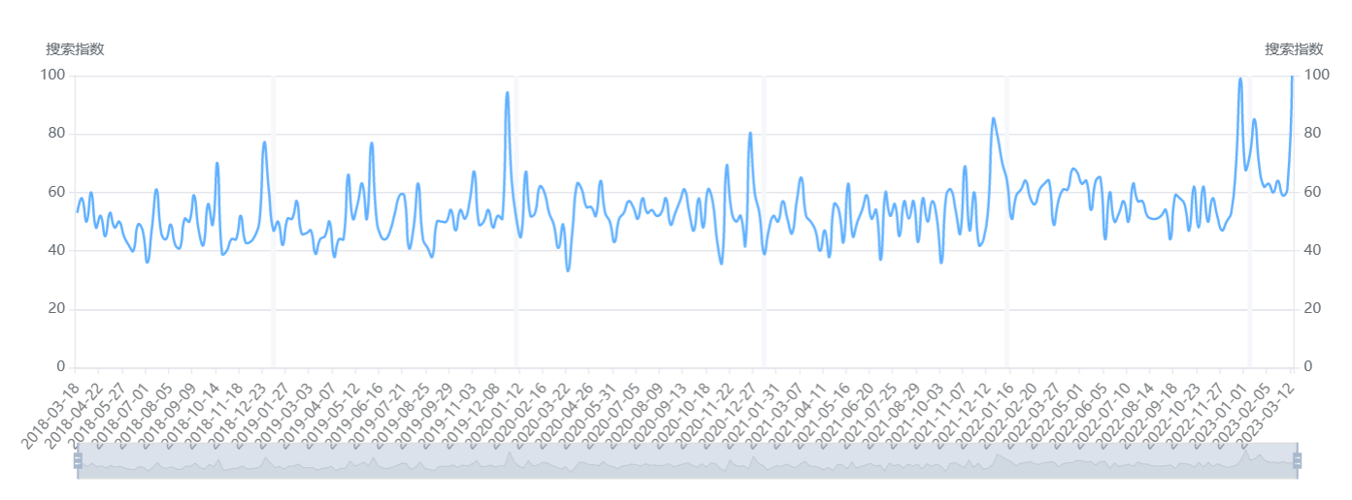
Channels to Validate an App
Google Trends
Chinese food （USA)
Chinese cuisine（USA)

Slide 14
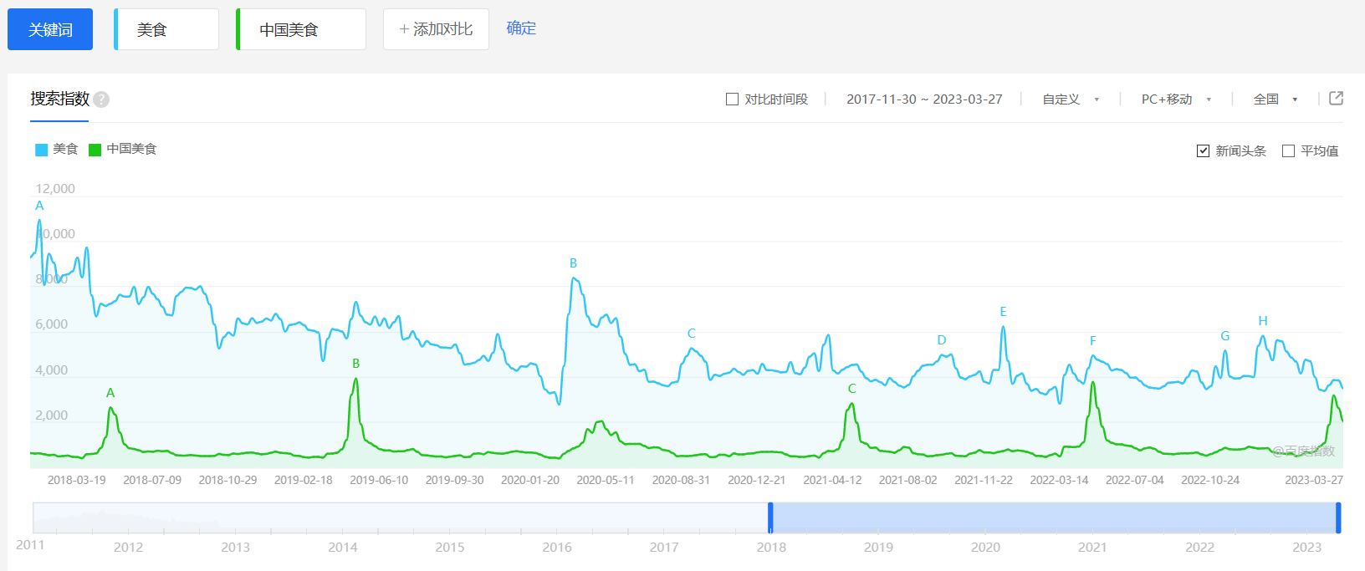
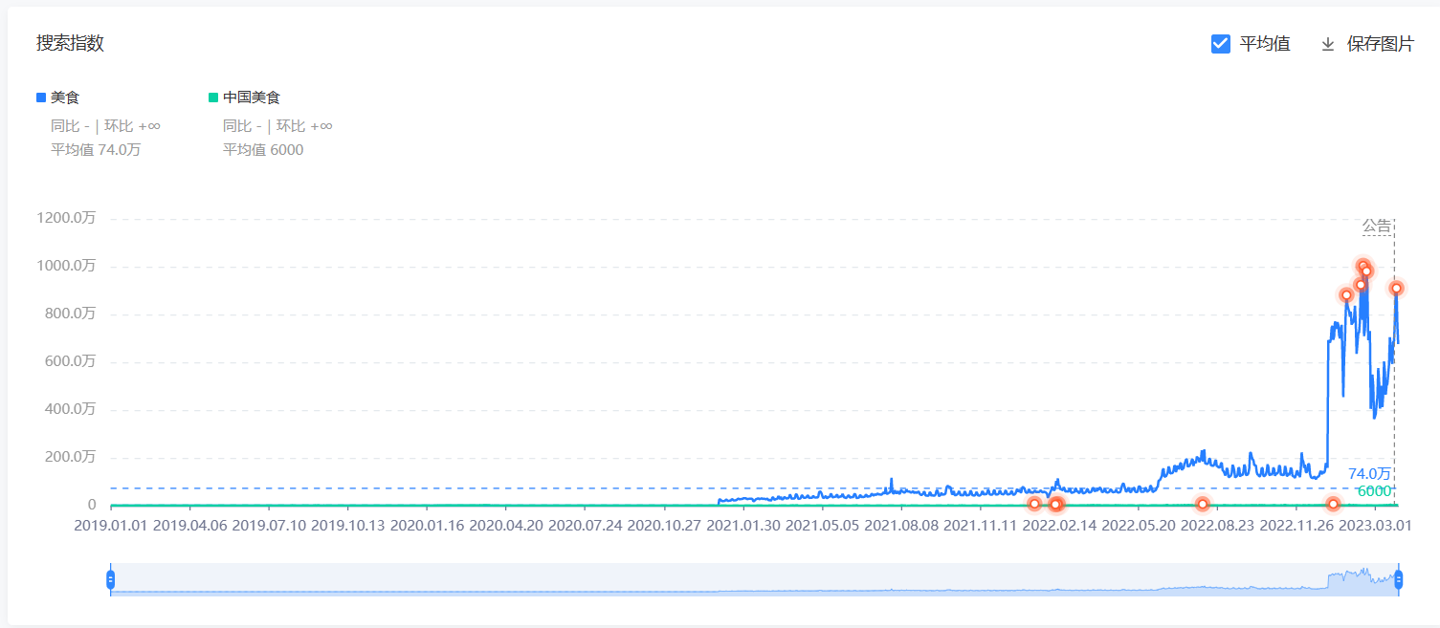
Channels to Validate an App
Baidu index
Douyin index

Slide 15
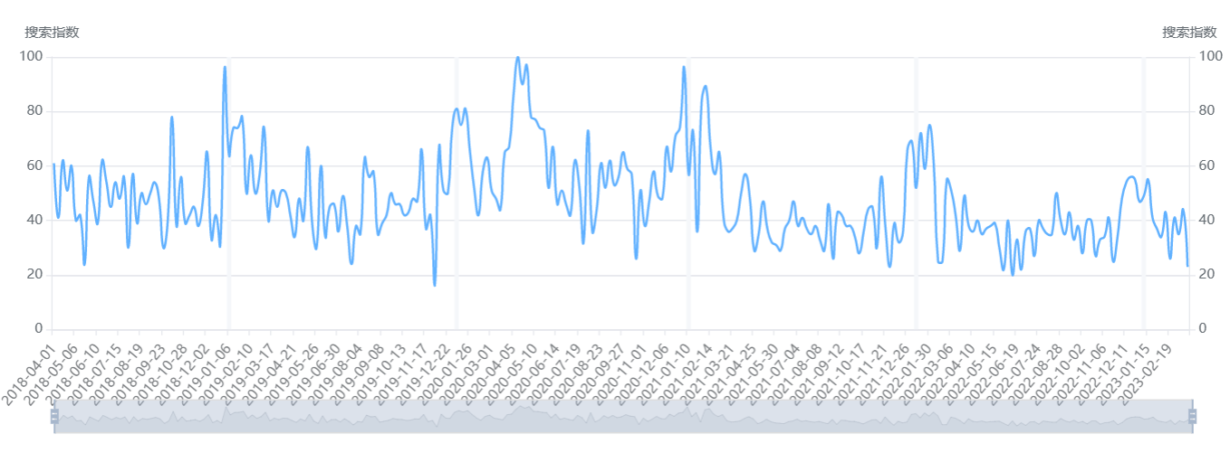
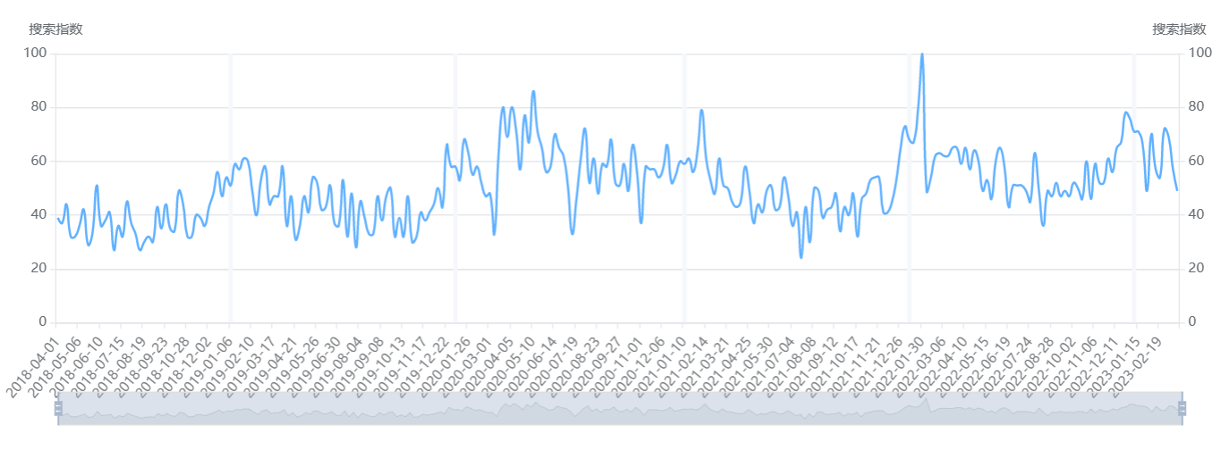
Channels to Validate an App
Google Trends
Chinese food recipes(USA)
Chinese cooking(USA)

Slide 16
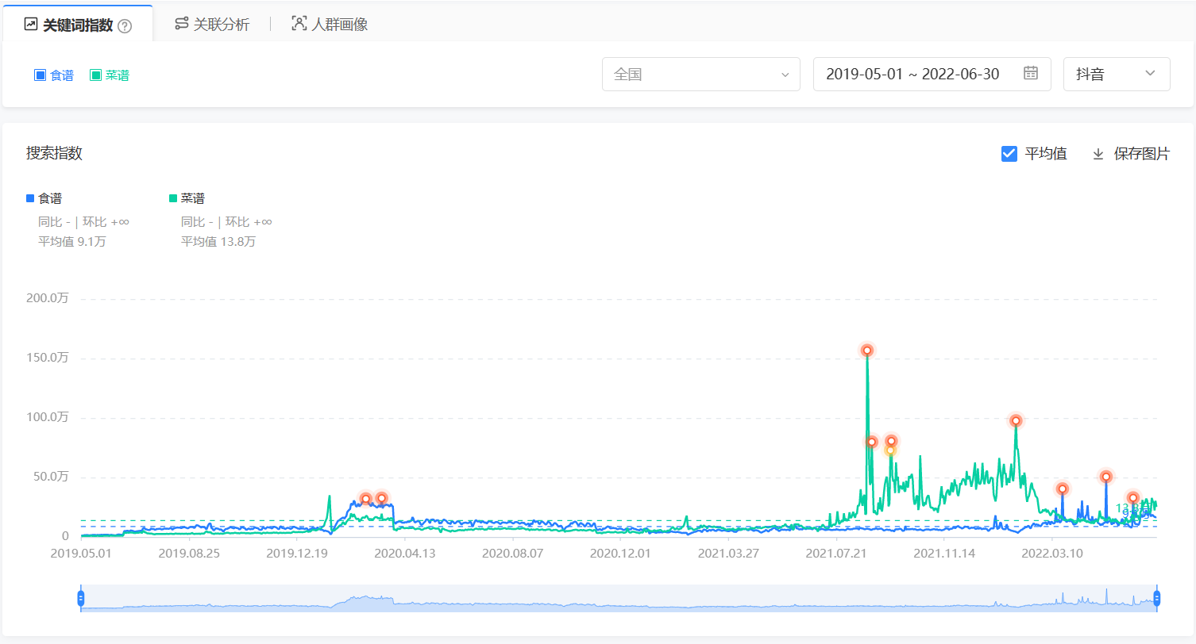
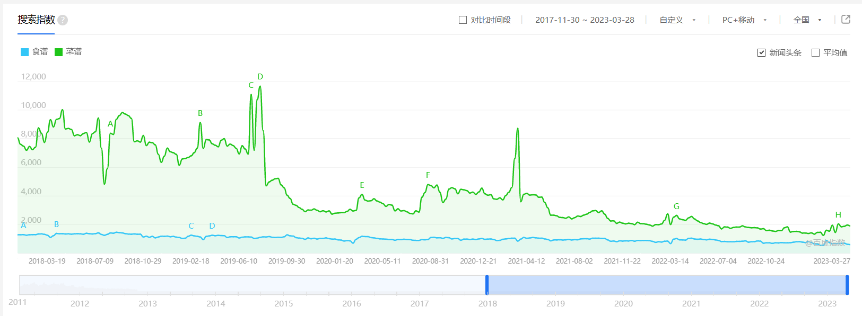
Channels to Validate an App
Baidu index
Douyin index

Slide 17
Operating
3

Slide 18
Operating
Product
Price
Introduce traditional Chinese food in both Chinese and English
A wide range of traditional Chinese food recipes with clear instructions and beautiful pictures
Provide features such as ingredient details, cooking videos, and stories about the cuisine
The app will be offered for free to attract users.
Provide a premium subscription service for users who want access to additional features
Place
Promotion
Distributed through major app store
A variety of marketing strategies will be used
Partner with Chinese restaurants or food bloggers
Publicize the brand and deepen users' cognition of the enterprise brand.
Form effective interaction with users.
Collect relevant hot topics

Slide 19
Financial Key Indicators
4

Slide 20
Financial Key Indicators
App type
App platform
Marketing strategy
Customer Acquisition Cost
App monetization strategy
User engagement
Retention rate
Lifetime Value
Other indicators
Burn rate
Runaway
Cash Flow
In-app purchases
Subscription fees
Advertising revenue
Profit

Slide 21
Thanks!

